Slide 1
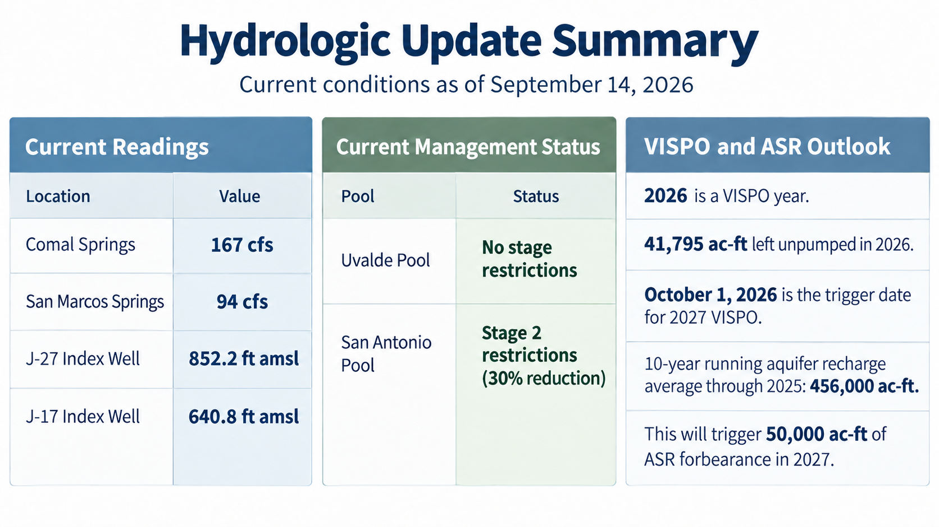

Slide 2
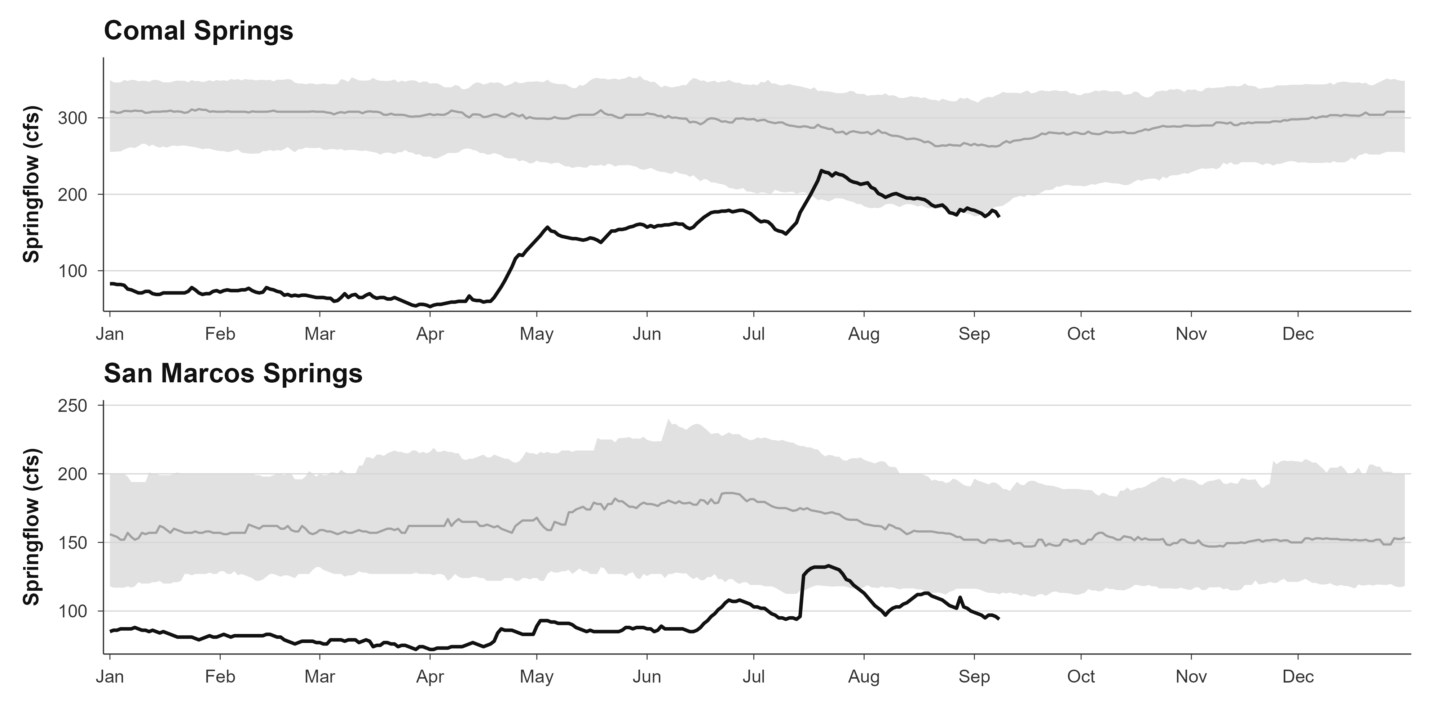
Daily mean springflow (cfs) at Comal (USGS 08168710) and San Marcos (USGS 08170000) springs during 2026 (through 2026-09-08). The shaded region represents the historical 25th–75th percentile range for each calendar day, with the gray line showing the historical median. Historical statistics are based on available pre-2026 observations from December 19, 1927–December 31, 2025 for Comal Springs and May 26, 1956–December 31, 2025 for San Marcos Springs.

Slide 3
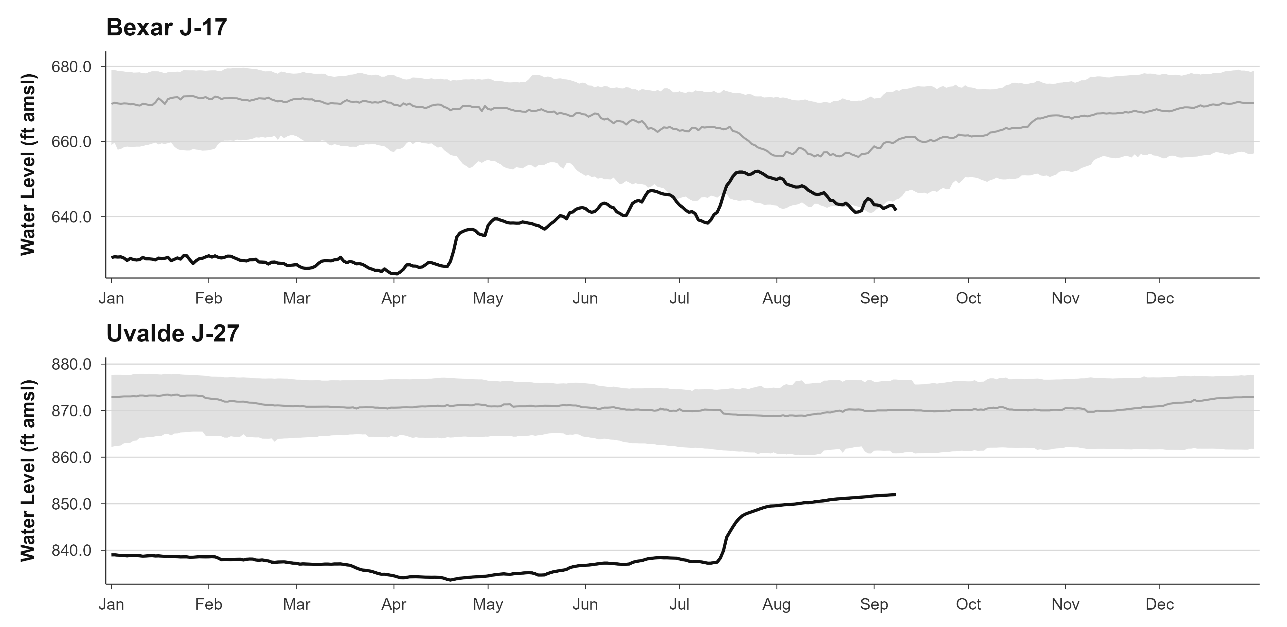
Daily high water levels at the Bexar J-17 and Uvalde J-27 index wells during 2026. The shaded region represents the historical 25th–75th percentile range for each calendar day, and the gray line represents the historical median. Historical statistics are based on available pre-2026 observations from November 12, 1932–December 31, 2025 for J-17 and October 24, 1940–December 31, 2025 for J-27.

Slide 4
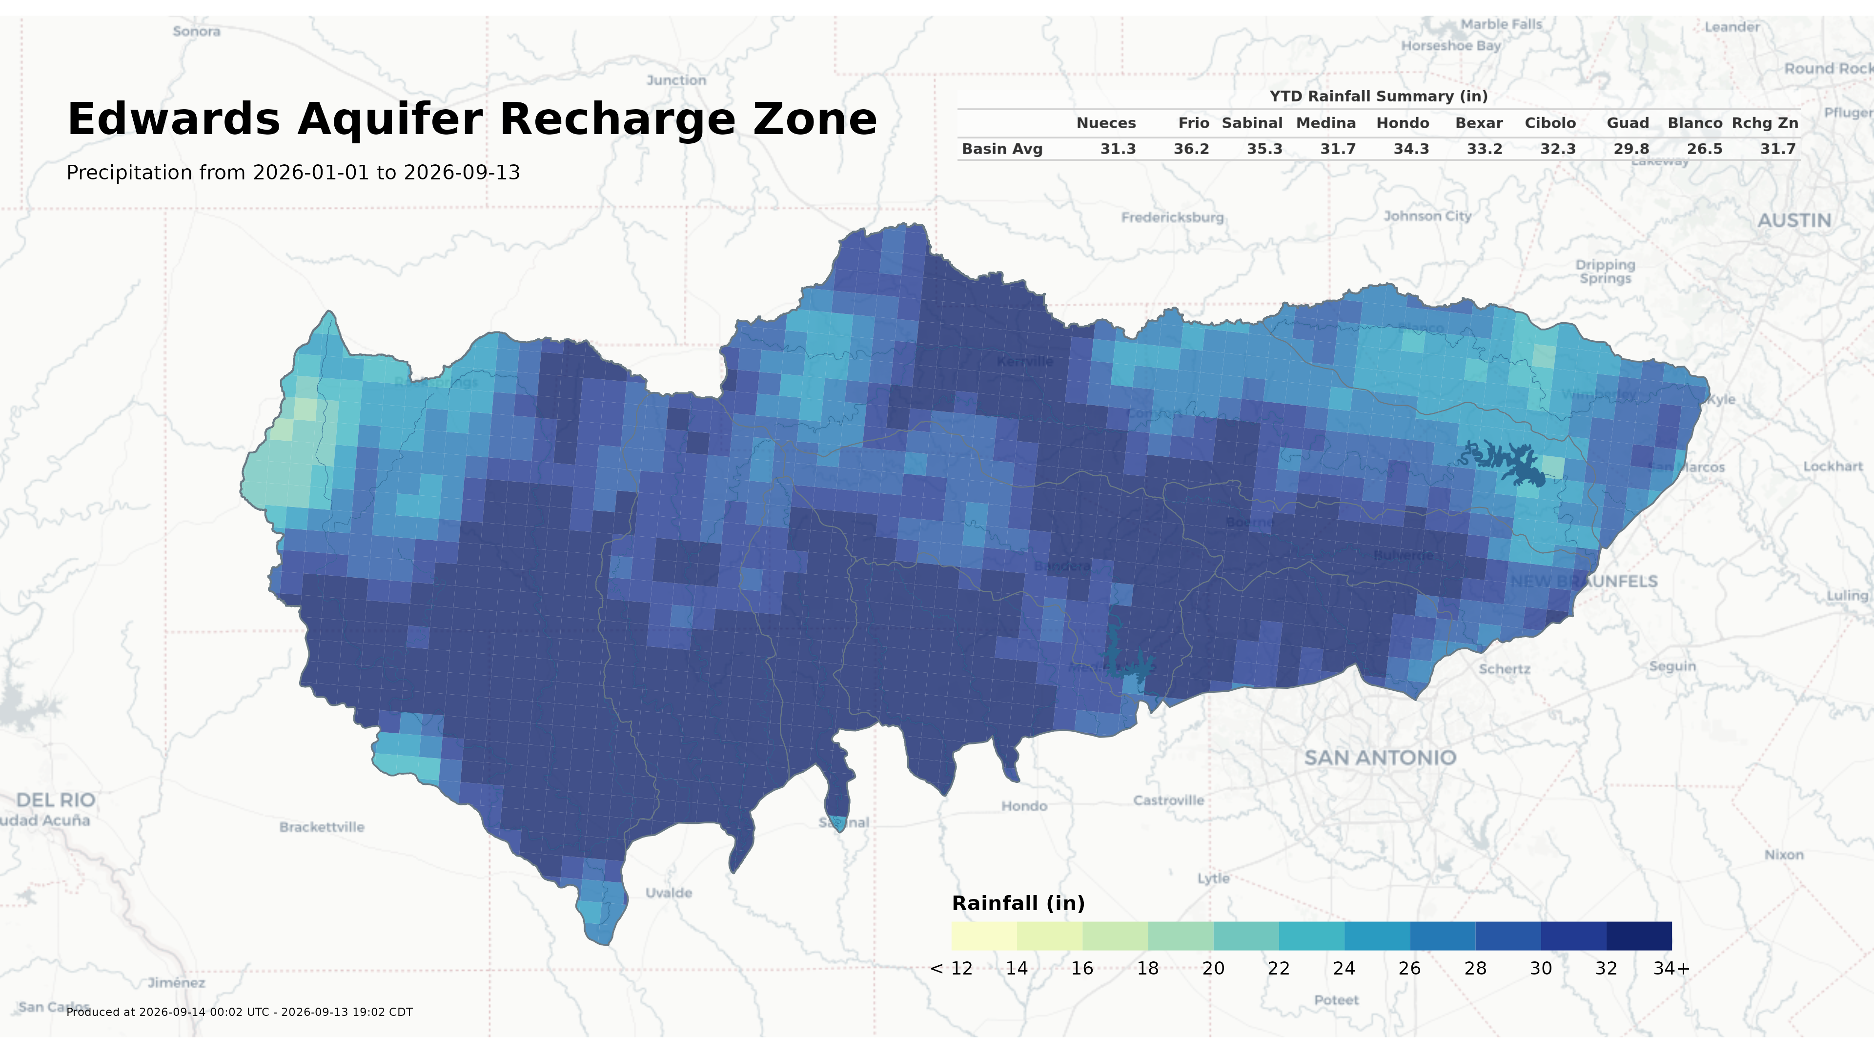
Edwards Aquifer Region

Slide 5
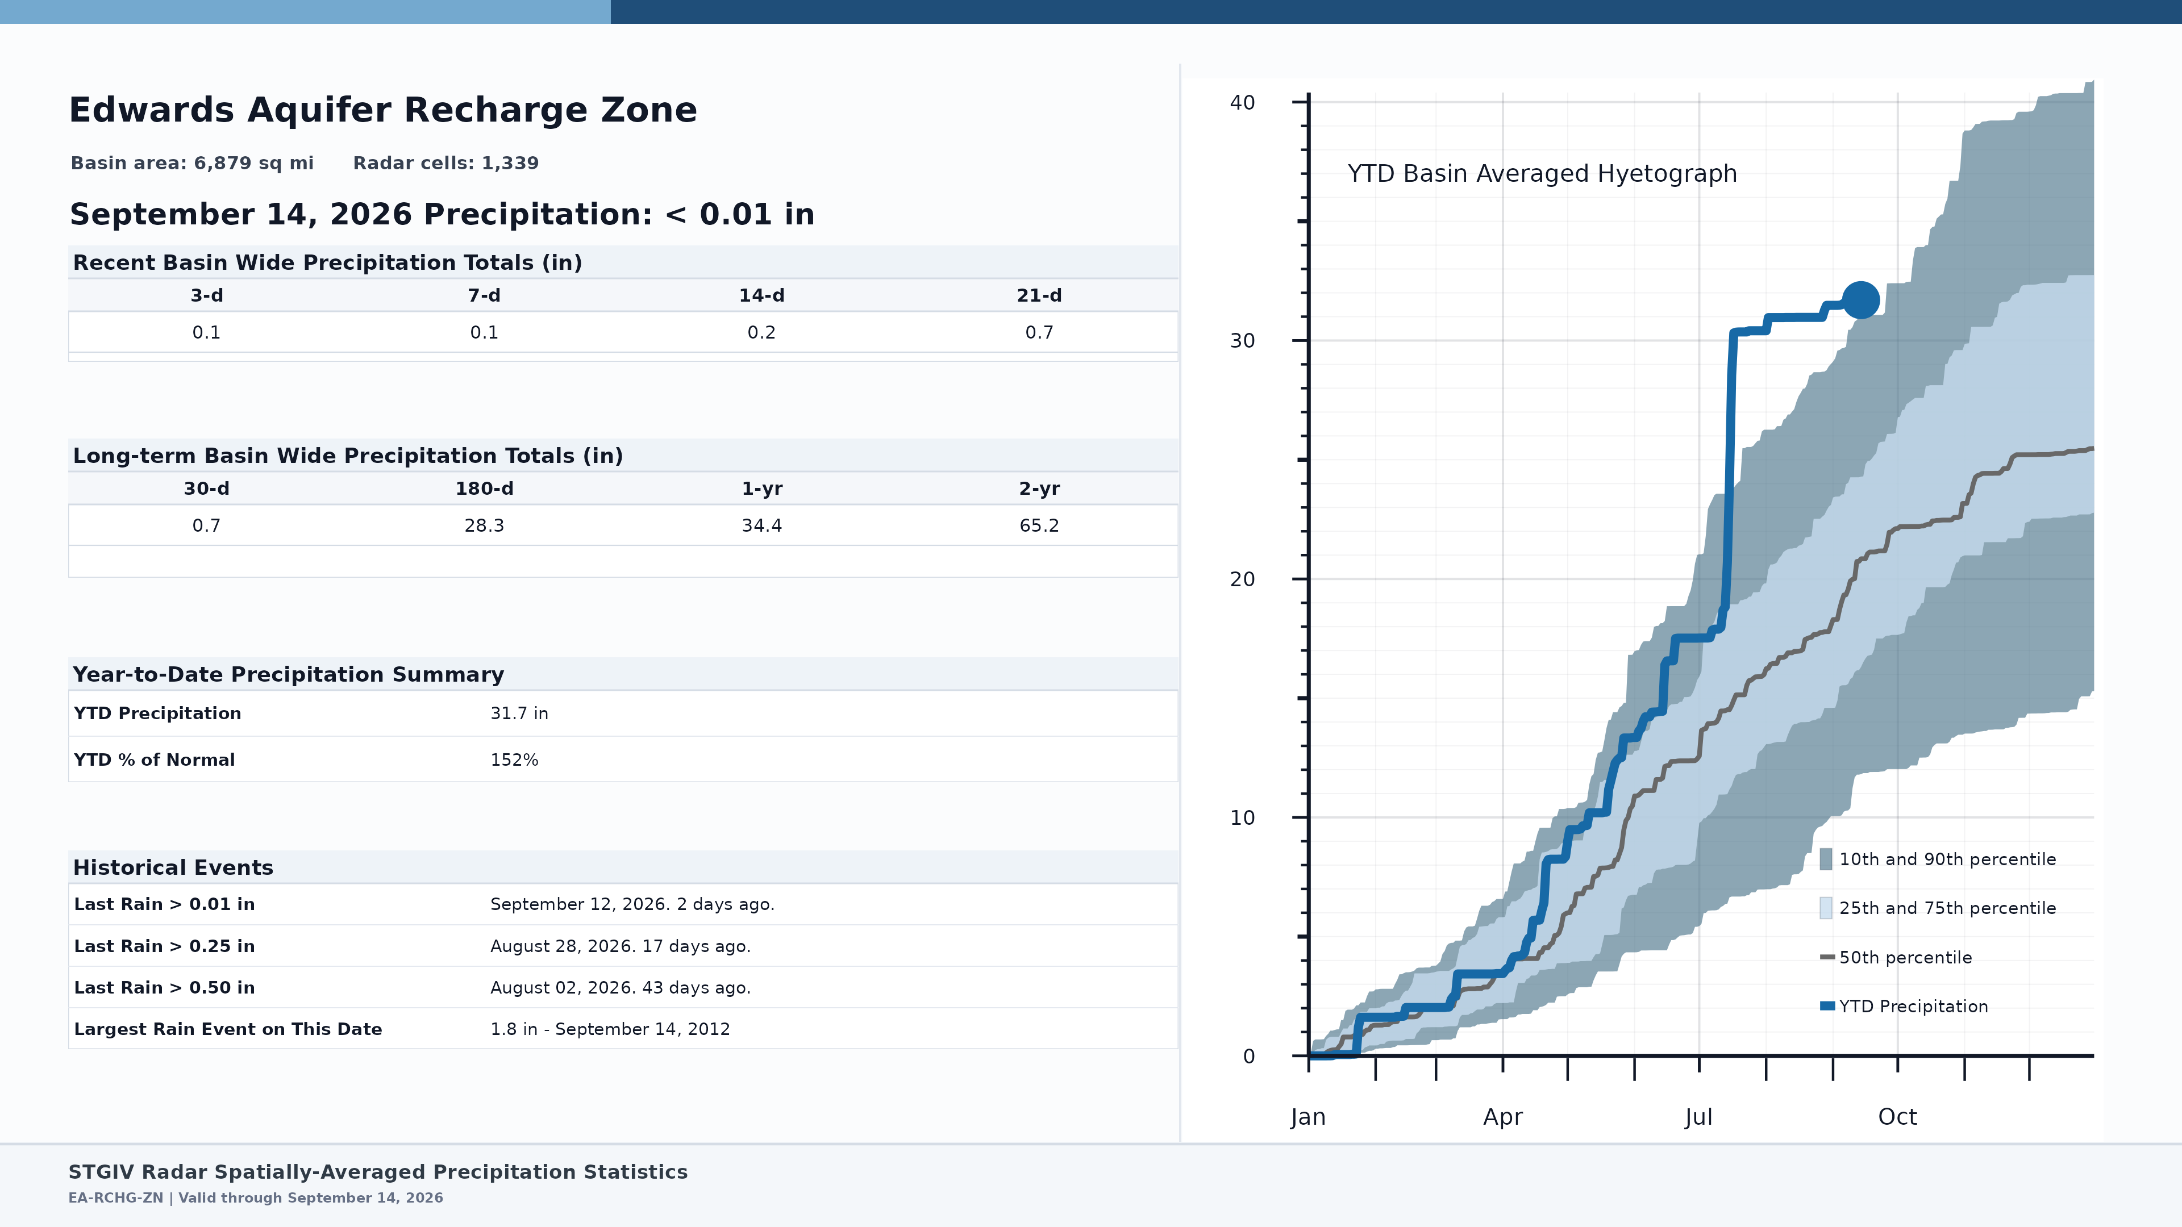
Edwards Aquifer Region

Slide 6
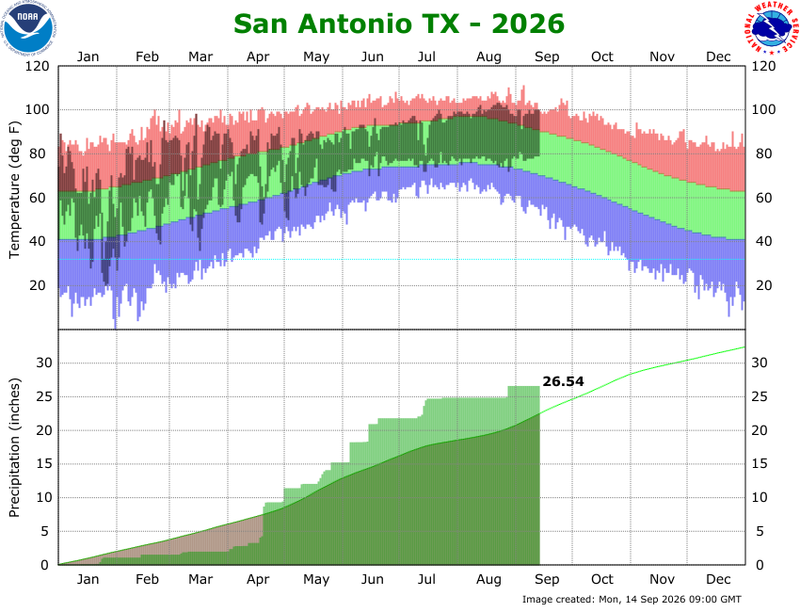

Slide 7
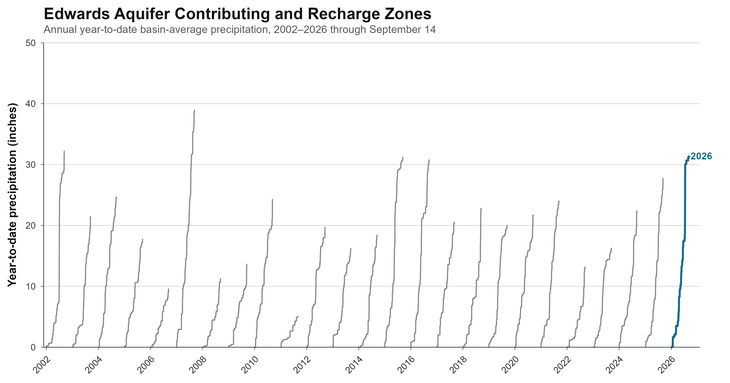

Slide 8
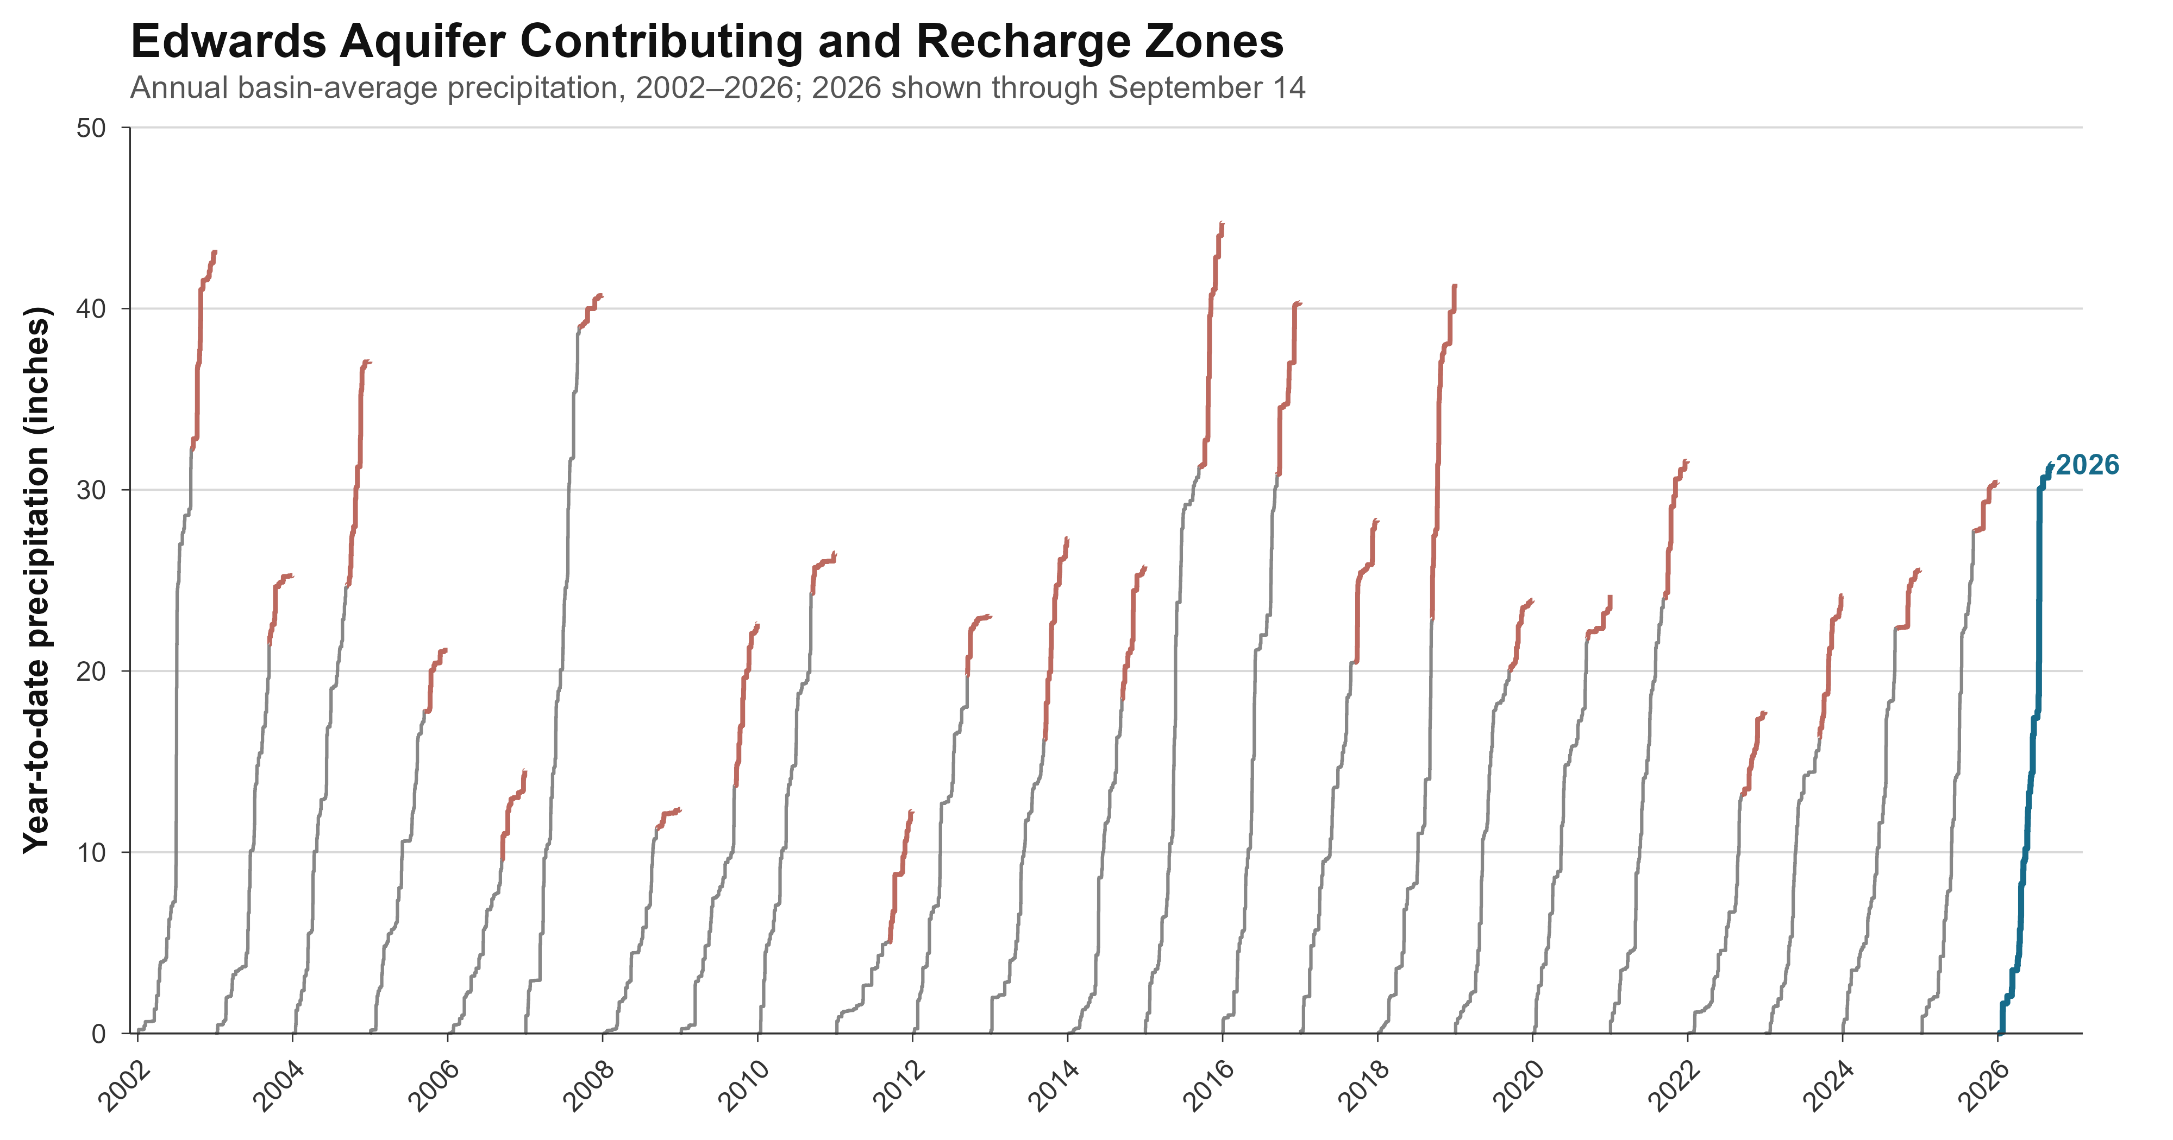

Slide 9
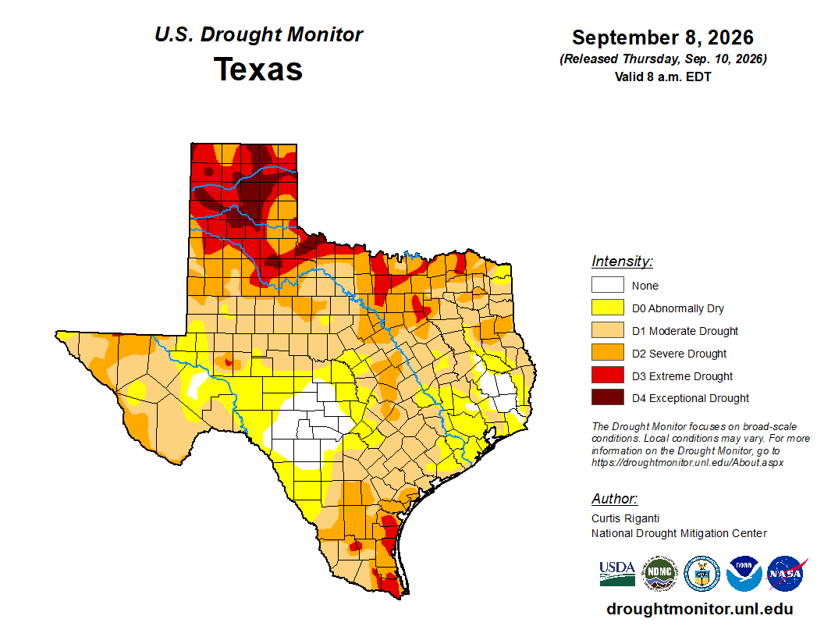

Slide 11
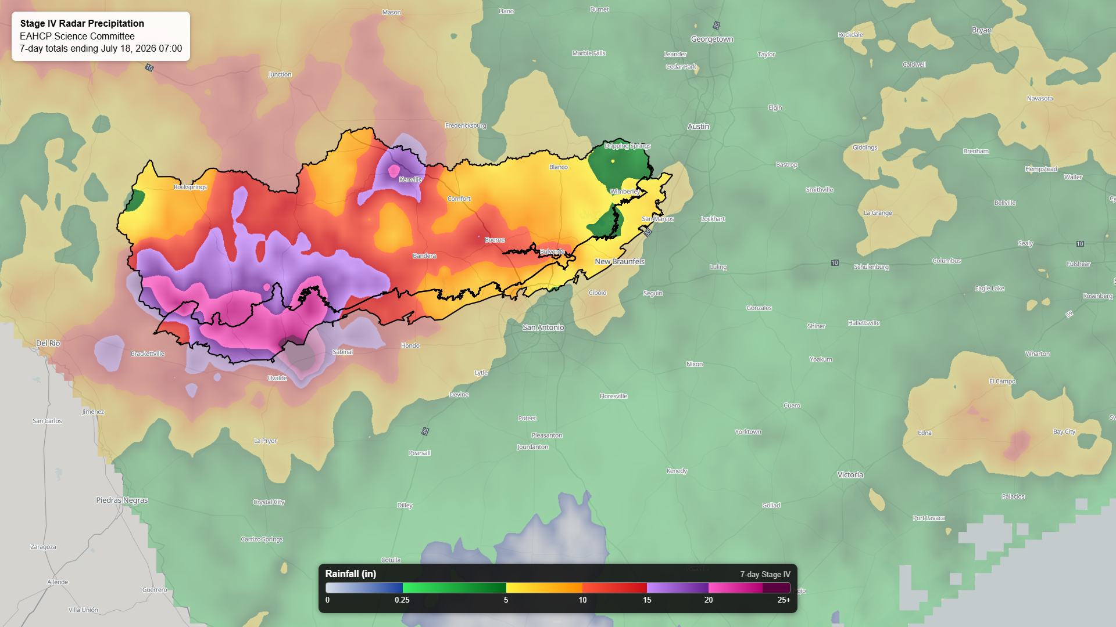

Slide 12
